Slide 1

New Hanover
Comprehensive Plan
Maggie Dobbs, AICP
September 11, 2019

Slide 2
Timeline
 | 2019 |  |  |  |  |  |  |  |  | 2020
 | 4 | 5 | 6 | 7 | 8 | 9 | 10 | 11 | 12 | 1 | 2 | 3 | 4 | 5 | 6 | 7 | 8 | 9 | 10
Background Research
Goals Identification
Stakeholder Interviews
Survey
Strategies Identification
Workshop
Draft Writing
Open House
Draft Review
Adoption

Slide 3
Agenda
Review of topic: Natural and Historic Resources
Logo
Survey update
Workshop
Next steps

Slide 4
Comp Plan Topic Schedule
2019
  May
    Preliminary issues identification
    Survey development
  June
    Housing and Population
    Survey development
  July
    Parks and open space
    Survey development
  August
    Transportation
    Survey finalization
  September (Survey launch)
    Natural and historic resources
  October
    Economic development
  November (Community Workshop)
    Workshop preparation
  December
    Future land use
2020
  January
    Community facilities and utilities
  February
    Government
  March
    Strategies development
  April
    Implementation chart development
  May (Open House)
    Open House preparation
  June
    Open House feedback review
  July – October
    Review of draft plan

Slide 5
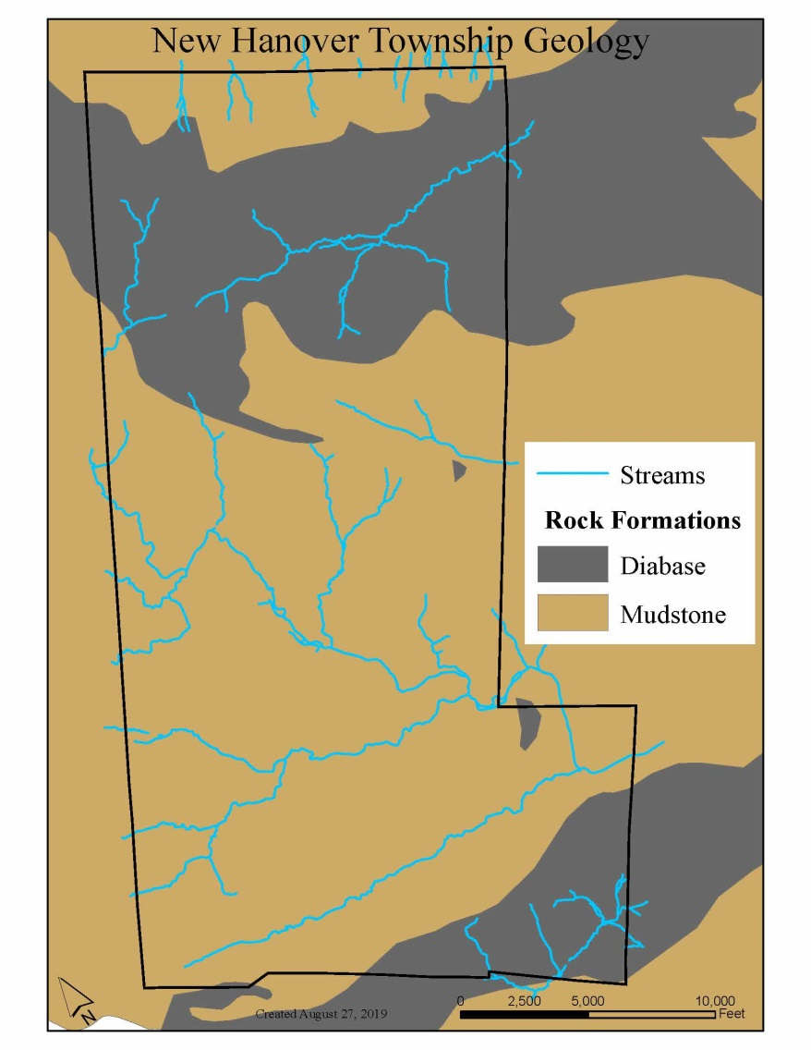
Geology
Underlying rock formations established the soil typology and hydrology of the region.
Diabase: hard rock, resistant to weathering, hilly and wooded.
Brunswick Formation: mudstone, shale, rolling hills

Slide 6
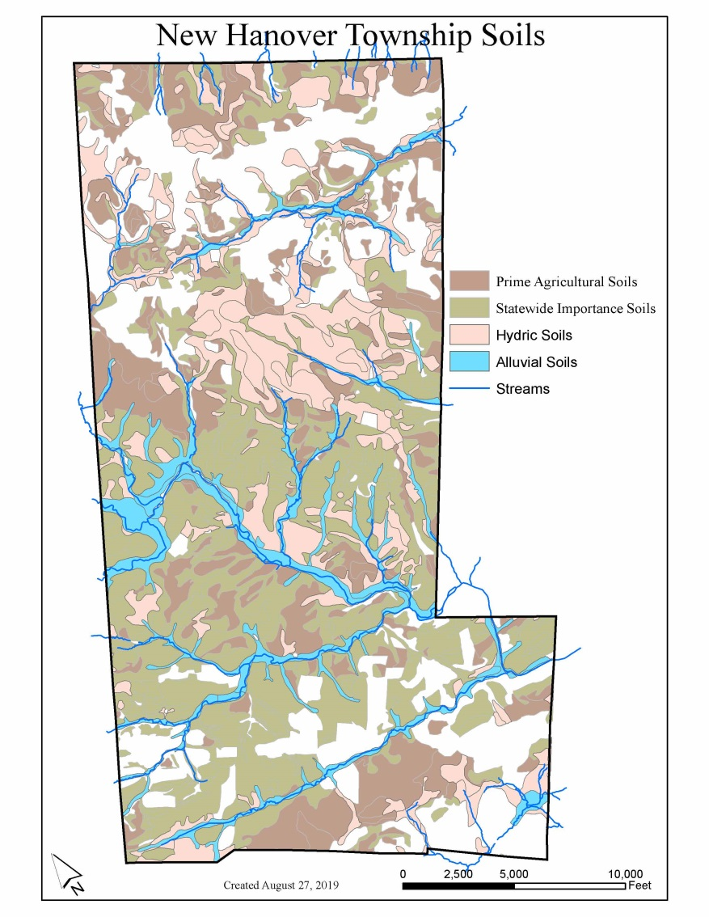
Soils
Soils can be characterized by their ability to support agriculture and capacity for infiltration
NHT soils require proper management for agriculture to maintain productivity
Generally, soil types limit infiltration which contributes to stormwater runoff and flooding conditions

Slide 7
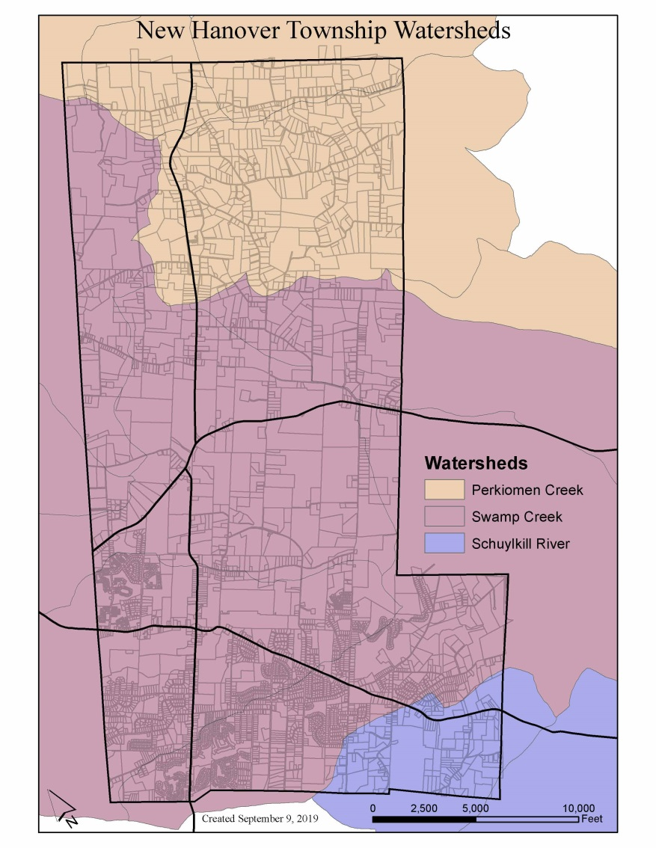
Watersheds
NHT belongs to three watershed areas, with the majority of the township located in the Swamp Creek Watershed.
Each watershed is managed by an Act 167 management plan that provide recommended best management practices based on watershed characteristics.

Slide 8
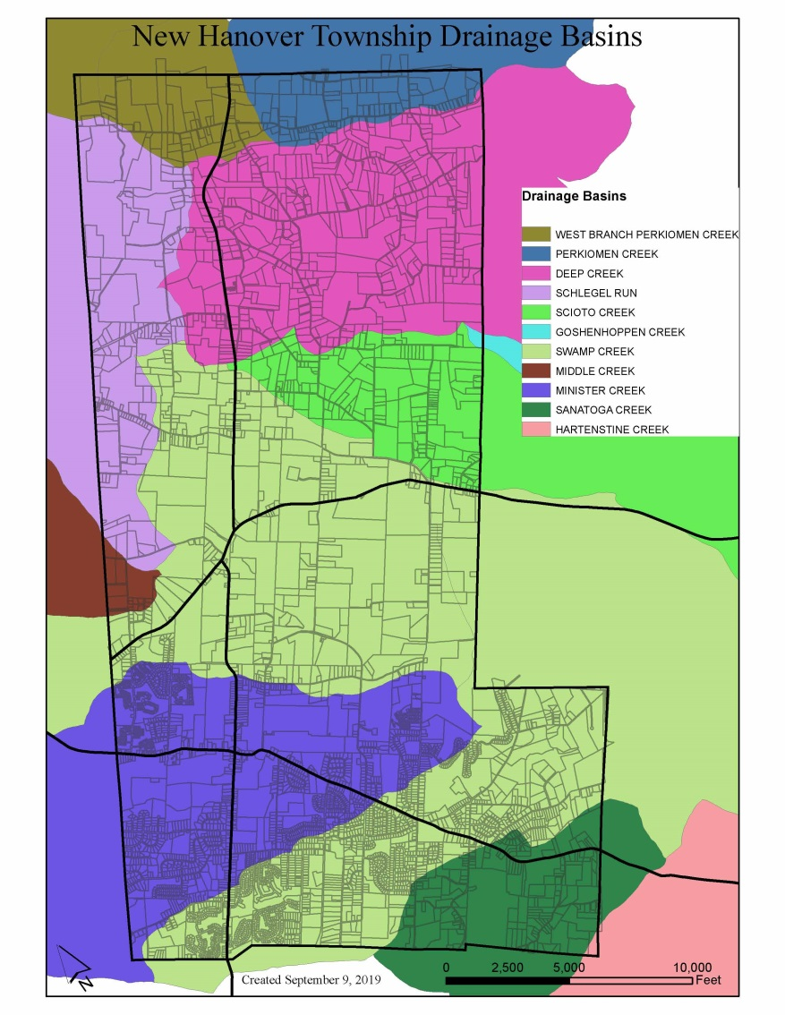
Drainage Basins
Smaller drainage basins make up larger watersheds.

Slide 9
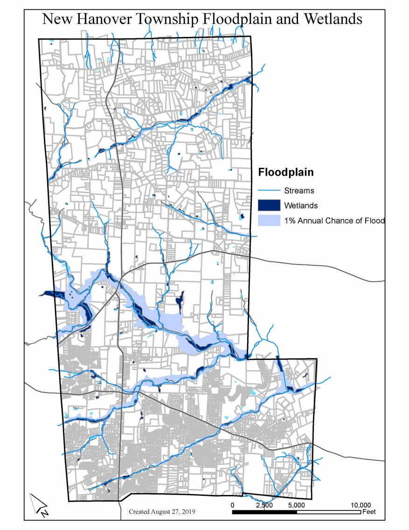
Floodplain and Wetlands
Areas within the floodplain are primarily found along the Swamp Creek. Most residential areas are outside of the floodplain. Properties within the floodplain qualify for federal flood insurance.

Slide 10
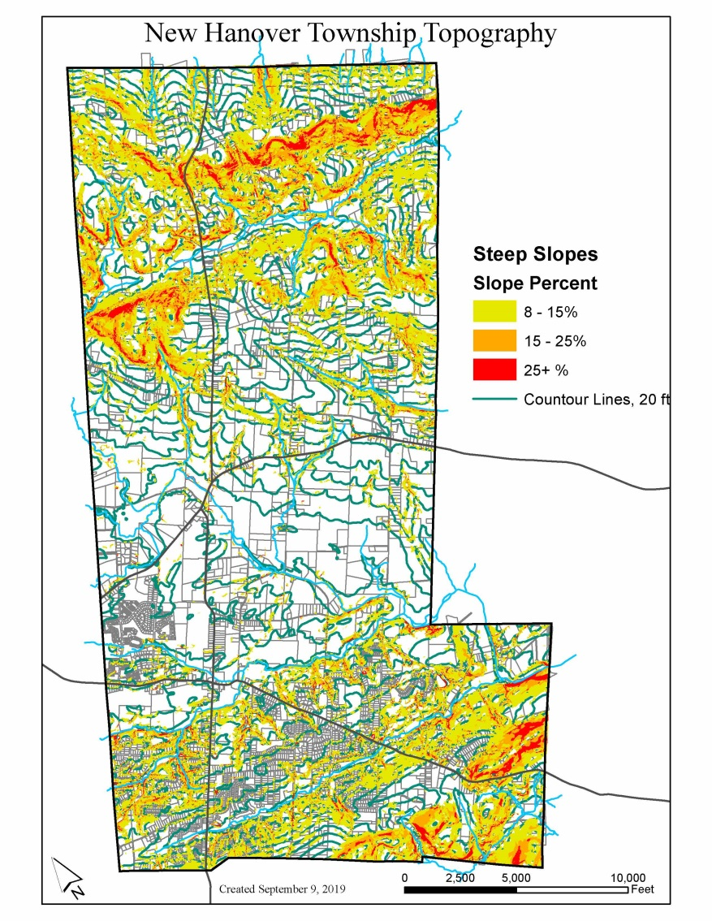
Steep Slopes
Major ridgelines are primarily found in the Deep Creek and Sanatoga Creek drainage basins (belonging to the diabase formation)
These areas are least suitable for development.

Slide 11
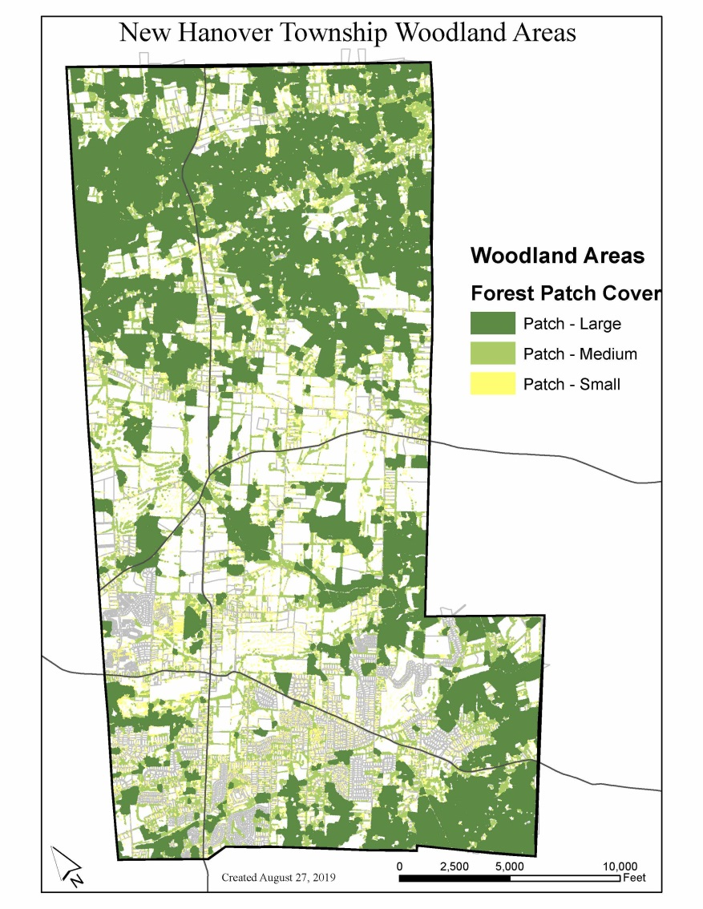
Woodlands
Wooded areas are concentrated where steep slopes are located which provides erosion control.
Larger, less fragmented woodland patches provide better wildlife habitat and contribute to stream health.

Slide 12
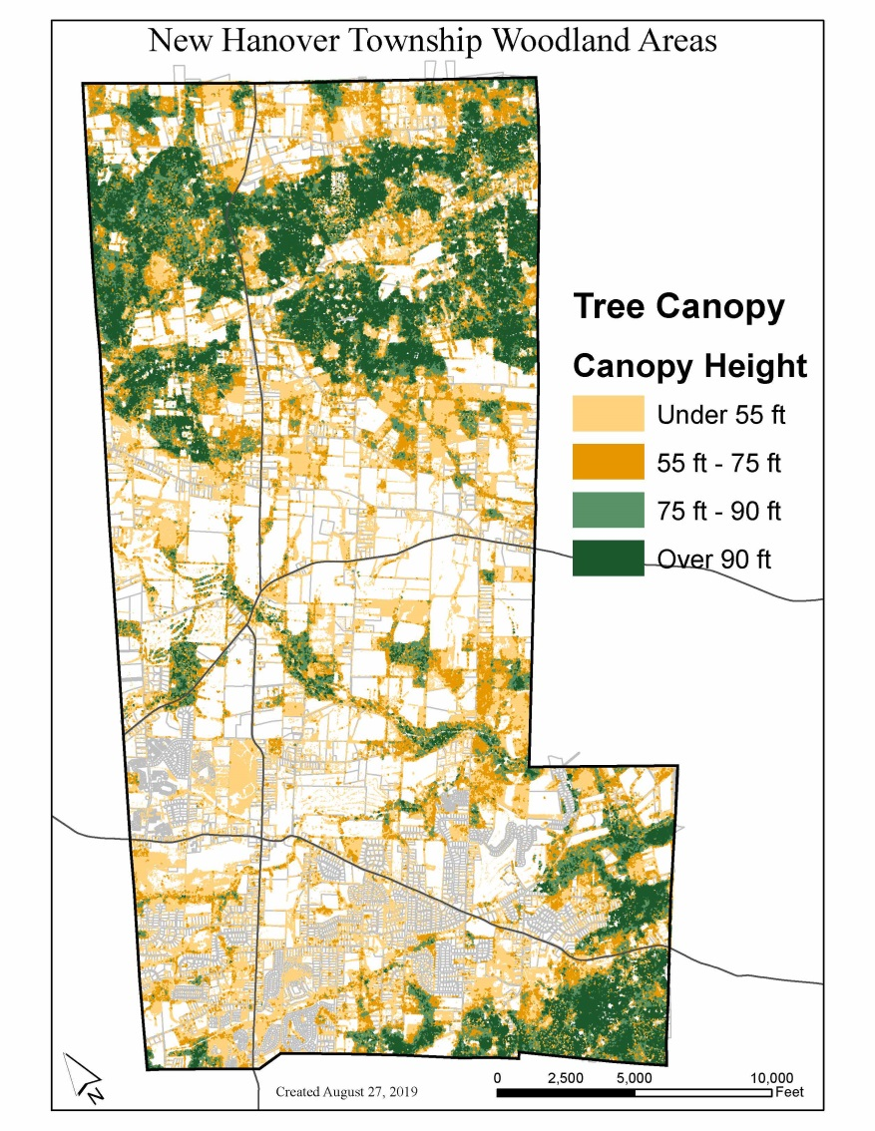
Canopy Cover
Taller tree canopies are found in the larger woodland patches, while shorter trees are primarily found in areas with recent development, and in agricultural areas.

Slide 13
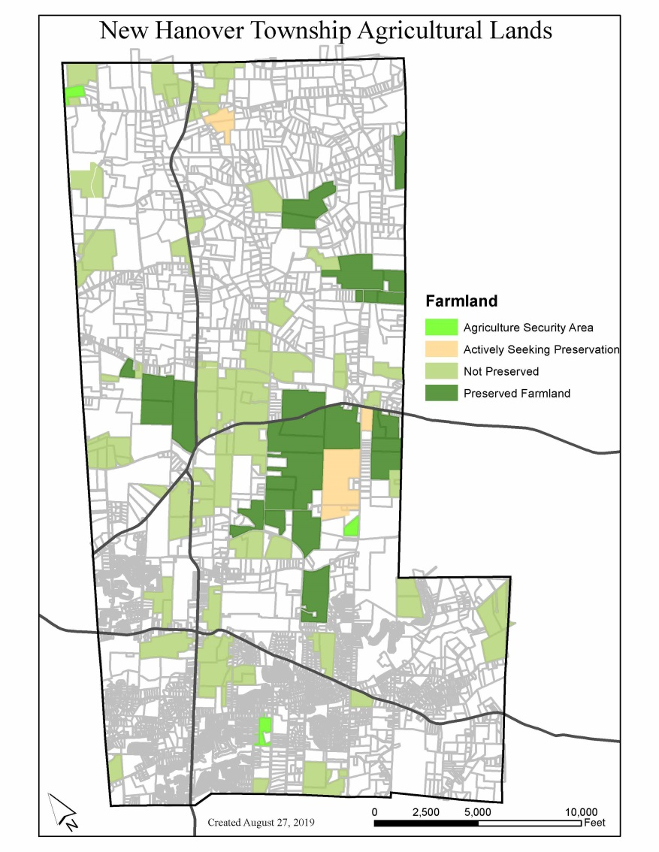
Agricultural Areas
Many properties under active agricultural uses are not preserved under the County’s farmland preservation program.
A portion of the central ag lands at 73/663 zoned for industrial and within the quarry site.

Slide 14
Ordinance Language
Existing language in the Zoning and Subdivision and Land Development Ordinances contain many provisions already for the preservation and protection of sensitive areas.
Opportunities for ordinance language improvements:
  Landscaping ordinance to promote appropriate landscaping standards within residential and nonresidential developments
  Species planting list to advocate for native plants
  Tree replacement

Slide 15
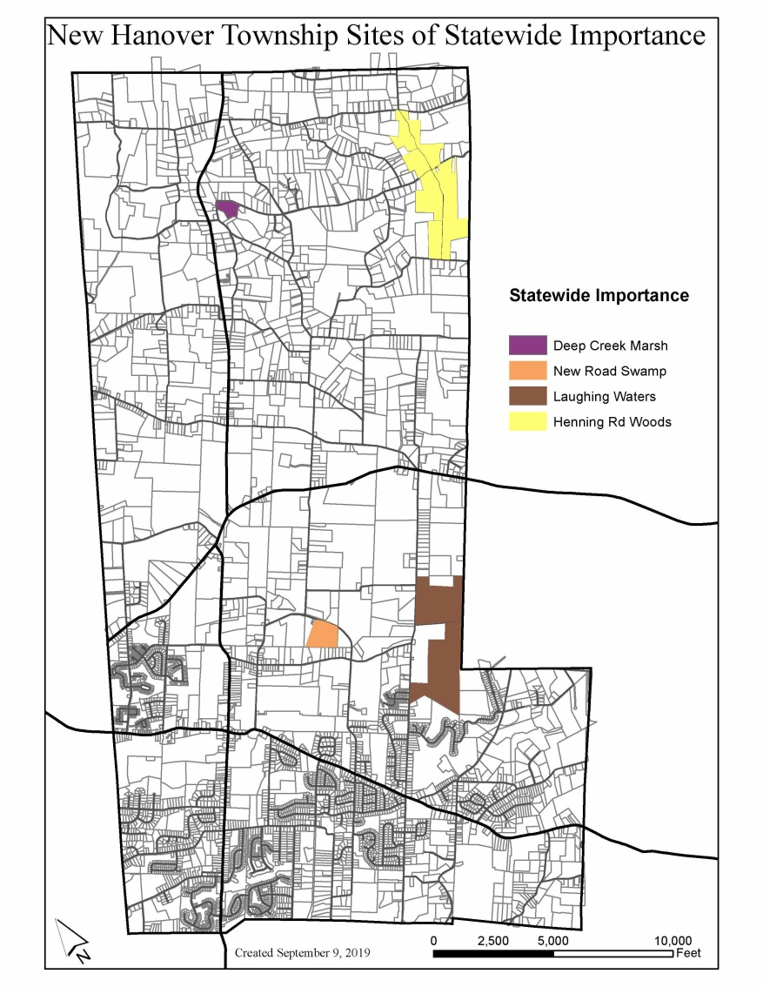
Sites of Statewide Significance
Two of the sites are already protected as township parks:
  Deep Creek Park
  Swamp Creek Park
Ongoing efforts to protect Laughing Waters through easements
Henning Road Woods not under protection

Slide 16
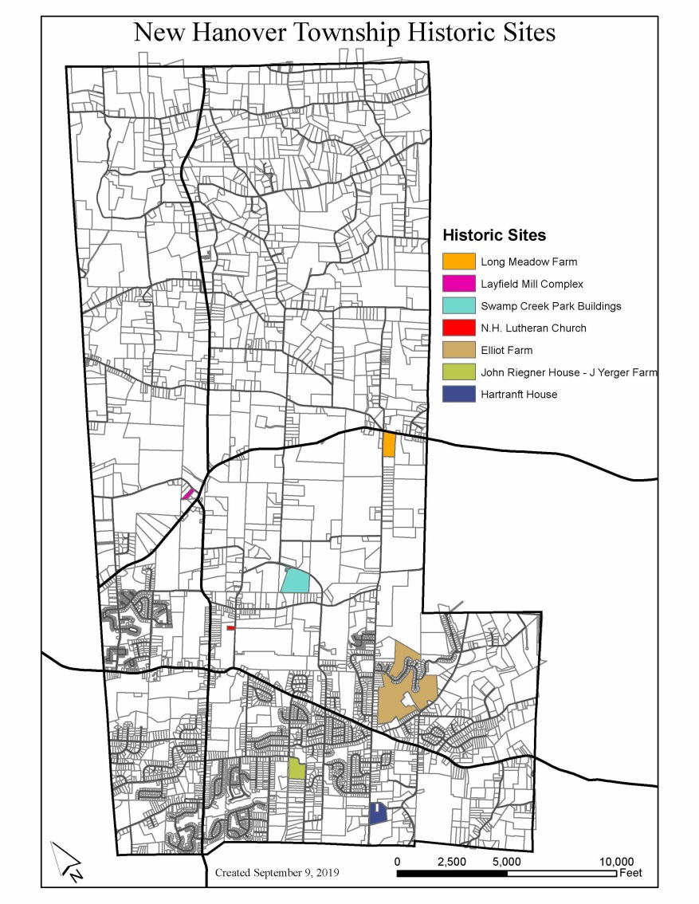
Historic Sites
Long Meadow Farm is under consideration for farmland preservation
Elliot Farm is considered private open space belonging to the Bella Vista Golf Course
Lutheran Church has a historical marker
Swamp Creek buildings are protected within the township park

Slide 17
Values Identification
Currently, there are many natural features that are in good health (large tree stands, unimpaired streams, etc.). The township should work to ensure these features remain in good standing through proper management.
What are some key areas for preservation that are not currently protected under existing policy structures or ownership?
What acquisition targets identified in the Open Space Plan are the most important to pursue?
What outreach has been/can be conducted to provide education to private property owners?
What ordinance amendments have been or should be considered?

Slide 18
Values Identification
Historic sites, vistas, and natural areas are important to the preservation of the cultural heritage of the township.
How important is it to preserve older and historic structures?
What kind of adaptive reuse may you want to consider for properties?
How do you envision engaging new members of the community with the township’s historic past?

Slide 19

Logo

Slide 20
Community Survey
Launched September 3
124 responses as of 9/11 (93 completed surveys)

Slide 21
Community Workshop
Select a date
Select a location
Options for structure
  Open House
    Posters and post-its as primary feedback collection
    Free flow of participants
    Come when you want, stay as long as you want
  Formal program
    Structured with a definite start/end time
    Presentation style with group break out sessions
    Table groups for in-depth discussions
Refreshments

Slide 22
Next Steps…
Submission to PC of background materials on upcoming topics
  October: Economic Development
  November: Workshop preparation
MCPC will:
  Continue to administer online and paper survey
    Survey officially launched September 3

Slide 23
Questions or comments?
Maggie Dobbs, AICP
610 292-4917
mdobbs@montcopa.org

